Slide 1
NYP CNC AI Chatbot Helper
By Ilysia and Bryan

Slide 2
01
PROJECT BRIEF

Slide 3

Project Overview
Aim:
To build an AI chatbot tailored to the NYP Data Classification Systems with the goal of helping staff quickly and accurately answer CNC-related questions, reducing reliance on manual searches through documentation

Slide 4
02
BRYAN’S PART

Slide 5
Recap ( What was implemented Previously )
Implemented a data processing workflow
A main function that takes in the file path as well as the collection name to separate data classification and chat function
The file path is passed to langgraph’s integration of unstructured with text loader to extract the text and convert it into langchain document object
This is then passed to a keyword tagger that uses open ai to extract 5-10 keywords from the document as a list of strings and assigning it as metadata
The document is then passed into a semantic chunker to chunk the data into larger but more effective chunks, reducing redundancy while still understandable
Batching the chunks for efficiency before inserting into the vector store ( chroma db )
Building file upload integration ( SIngle File )
Receiving the file from the front end
Write it to a temp folder
Doing data processing on the file folder
Moving the file to the correct file folder where each folder is labelled by the file type

Slide 6
Features Implemented
File Upload
Rewriting the code to accommodate file uploads from multiple users
Multi File upload
Data Classification
Implementing and Improving the data classification
Chat Model
Incorporating the metadata tagger within the retrieval
Implementing persistent memory
Implementing a filing system for user data and data used by internal processes
Notes:
There are other smaller features such as making the chat id be the username and a timecode in utc time and putting in capabilities to show the time in the appropriate local time.

Slide 7
02.a
File Upload

Slide 8
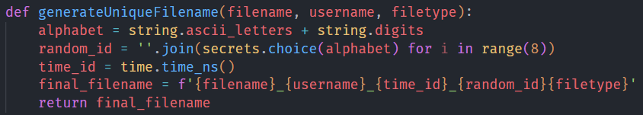
File uploads part 1: A system for multiple users
Potential Issue
FIle being labelled wrongly with the wrong file extension
The need to track the uploaded files in a system built for multiple users for security
Each users should only see the files they uploaded as well as the base knowledge
Solution
The magic module detects file types based on the encoding instead of simply the file extension and then the correct file extension can be attached to the file being stored so it can be accessed and processed properly
By putting the key information on the file name itself such as user, time it was created as well as a random letters to ensure the file name is unique, we can filter it later on if we so choose to

Slide 9
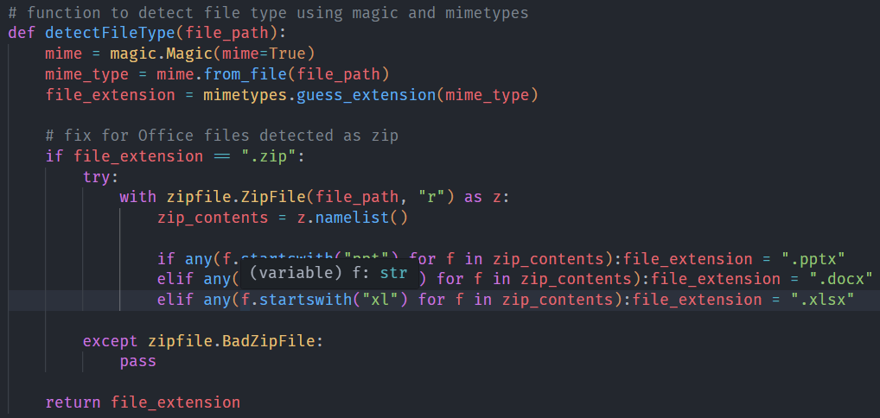
File uploads part 1: A system for multiple users
Function to detect and return the actual file type

Slide 10
File uploads part 2: Multi File uploads
Potential issues
It is an essential feature as well as a potential pain point when someone wishes to upload multiple files.
Edge case of race conditions due to changes on how files are being handled as it is being processed to accommodate previous part
In the current code logic, uploaded files are copied from the temp folder to the appropriate folders instead of moved which leaves behind the original file in the temp folder. The original file is unwanted so the temp folder after the data processing. Therefore, there is a clash when multiple files are writing to and deleting the temp folder causing a race condition
Solutions
The front end file uploader has the option to take in multiple files and it returns a list of the file objects that can be iterated through to send each file object back to be processed
Instead of one temp folder, a discreet unique temp folder be made for each file uploaded with a unique folder name so that they don’t have race conditions
Front-end feedback to the user
Keeping a counter to track which files succeeded and which failed and display it

Slide 11
02.b
Data Classification

Slide 12
Implementing and Improving Data Classification
Consideration to the logic of data classification
For data classification, the algorithm is to extract the text. Pass the first 40k and the last 40k characters to the data classification model to classify. This approach might hinder the a full understanding of the document. Furthermore, the large language model doesn’t need to be limited to accepting only the first and last 40k as the context window is big enough to be able to handle the retrieval with this large of input.
The data classification model is a direct adaptation of the chat model in which it creates multiple rephrasings of the input and then it rephrases using the function create history aware retriever it to be a stand alone paragraph to retrieve the relevant documents given as mentioned above it truncates the document text. Therefore the history aware retriever is unnecessary if I were to pass the entire document to the model.
Changes made
Extract and pass contents of the whole file to the model using the already set up data processing functions
Removed the history aware retriever and send the results of the multi question rephraser to the retrieval chain

Slide 13
02.c
Chat Model

Slide 14
Incorporating the metadata tagger within retrieval
Obstacles Encountered
Limitations of chroma
Chroma cannot take in a metadata that contains complex data types and can only take in strings, integers and booleans
Chroma can only do an exact matching for string metadata when doing filtering
Solutions Implemented
Change the keywords metadata from one array of strings to multiple keywords dictionary elements of strings, this is to get around the first limitations of complex data types while splitting them up to accommodate the exact matching
Furthermore, to facilitate the exact matching, a function was written to utilize open ai chat gpt to do text classification to match the question to the existing keywords which is in a databank ( collected into a list and stored into a persistent storage using shelve at the data processing stage )
This is the best method to do the data labelling / text classification task without any existing training data

Slide 15
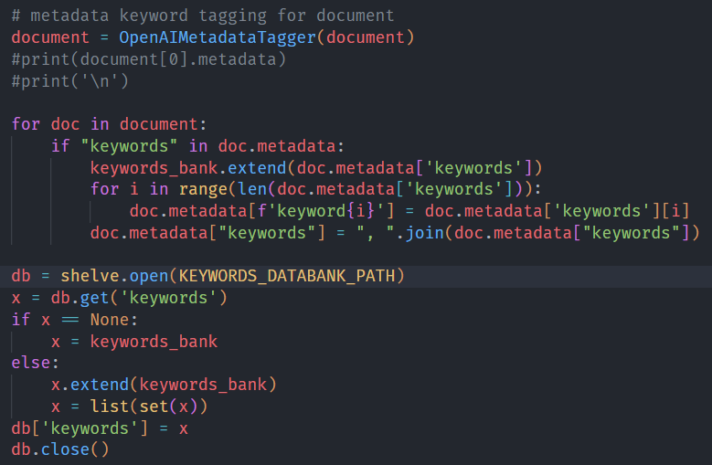
Incorporating the metadata tagger within retrieval
Keywords databank logic in dataProcessing.py

Slide 16
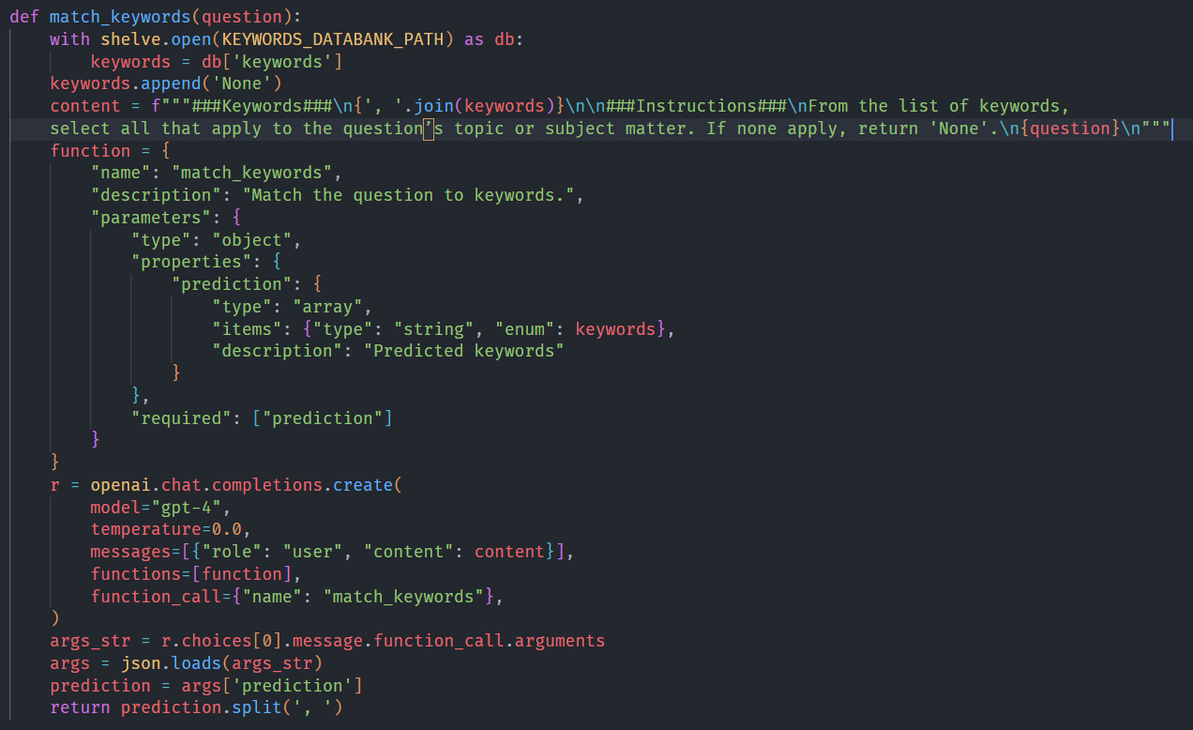
Incorporating the metadata tagger within retrieval
Blank
Text Classification using Open AI

Slide 17
Implementing persistent memory and a filing system
Existing issues
The MemorySaver method provided by langchain only saves in memory, so once the python file stops running the memory is lost which is a major flaw, therefore there is a need for persistent memory logic
As of the previous batches, the memory was stored in the log file and in a postgres database but merely as a record, the user had no access to the previous conversations which is to be expected with the conversation memory being temporary
Solutions
A proper solutions needs to address both, I did the backend and implemented an sqlite3 instance to replace the memory saver and act as a persistent memory and is controlled by the thread id which is stored in the front end’s conservation storage which is a json file for each conversation
As with the keywords file, sqlite 3, conversation history, uploaded files as well as the vector store, I decided to put them all into a folder to organize it better, all the paths are kept in the env file and I wrote a simple relative to absolute path function to deal with the components that require an absolute file path such as the sqlite3

Slide 18
03
ILYSIA’S PART

Slide 19
My Focus - Improving User Experience
Develop a chatbot that can process spoken input using Speech-to-Text
Implement conversation history tracking to enhance contextual understanding
Support multiple users with individualized data storage
Enhance secure user registration based on the allowed email list
Evaluate and select appropriate tools and models for performance and scalability

Slide 20
Timeline
Wk 3
Wk 6
Wk 9
Wk 12
Sprint 1
Sprint 2
Sprint 3
Sprint 4
Project Understanding
Evaluate Previous UI
Completed 1st Prototype
Compare vector databases
Speech-to-text Function
Testing the accuracy of the Speech-to-text function
Improve the UI
Redoing the conversation history using Flask
Testing the accuracy
Integration with Bryan’s Part
Handle multiple users
Final Report
Final Presentation Slides

Slide 21
Choosing the Right Vector Database
 | ChromaDB (used in V1.0) | PostgreSQL (used in V2.0)
Speed | ✅Fast vector search | Slower for larger queries
Scalability | ✅Optimized for AI workloads | Scalable with tuning
Accuracy | ✅Efficient ANN search | Requires vector extensions for optimal search
Persistence | Limited structured storage | ✅ Robust, data storage & history
Integration | ✅Easy to set up for AI apps | Requires Pgvector extension
Chosen: ChromaDB
Notes:
After evaluating several vector databases, we chose ChromaDB because it offers fast search, good scalability, and integrates seamlessly with LangChain — which made development much smoother.

Slide 22
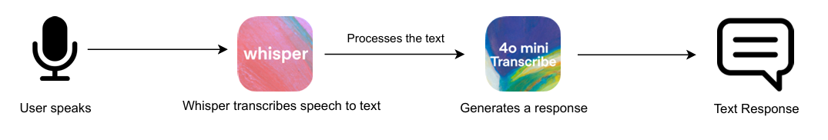
Speech-to-Text Integration
What can Whisper do:
Transcribes voice to text
Supports multiple languages, noise robustness
Lightweight and open-source
How speech gets transcribed to text:
Final STT Setup: GPT-4o Mini + Whisper
Notes:
For speech-to-text, we compared GPT-4o and GPT-4o Mini. While GPT-4o has more advanced NLP, we chose GPT-4o Mini because it’s faster, cheaper, and still accurate enough for our needs. Pairing it with Whisper gave us a lightweight, effective solution.

Slide 23
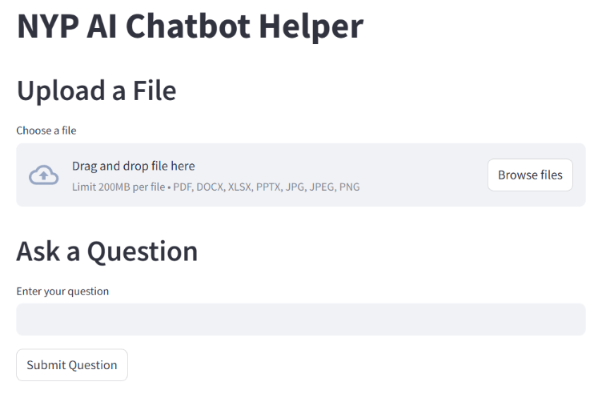
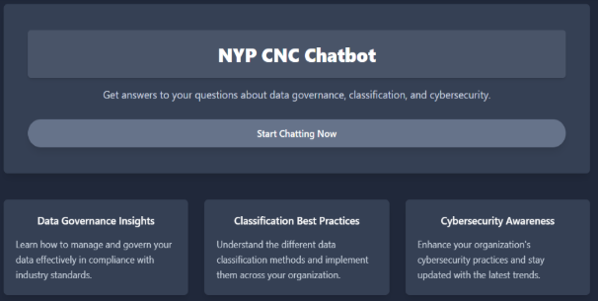
Learning from Past UI Versions
Version 1.0
Version 2.0
Visually Compressed
Crowded
Not fully interactive

Slide 24
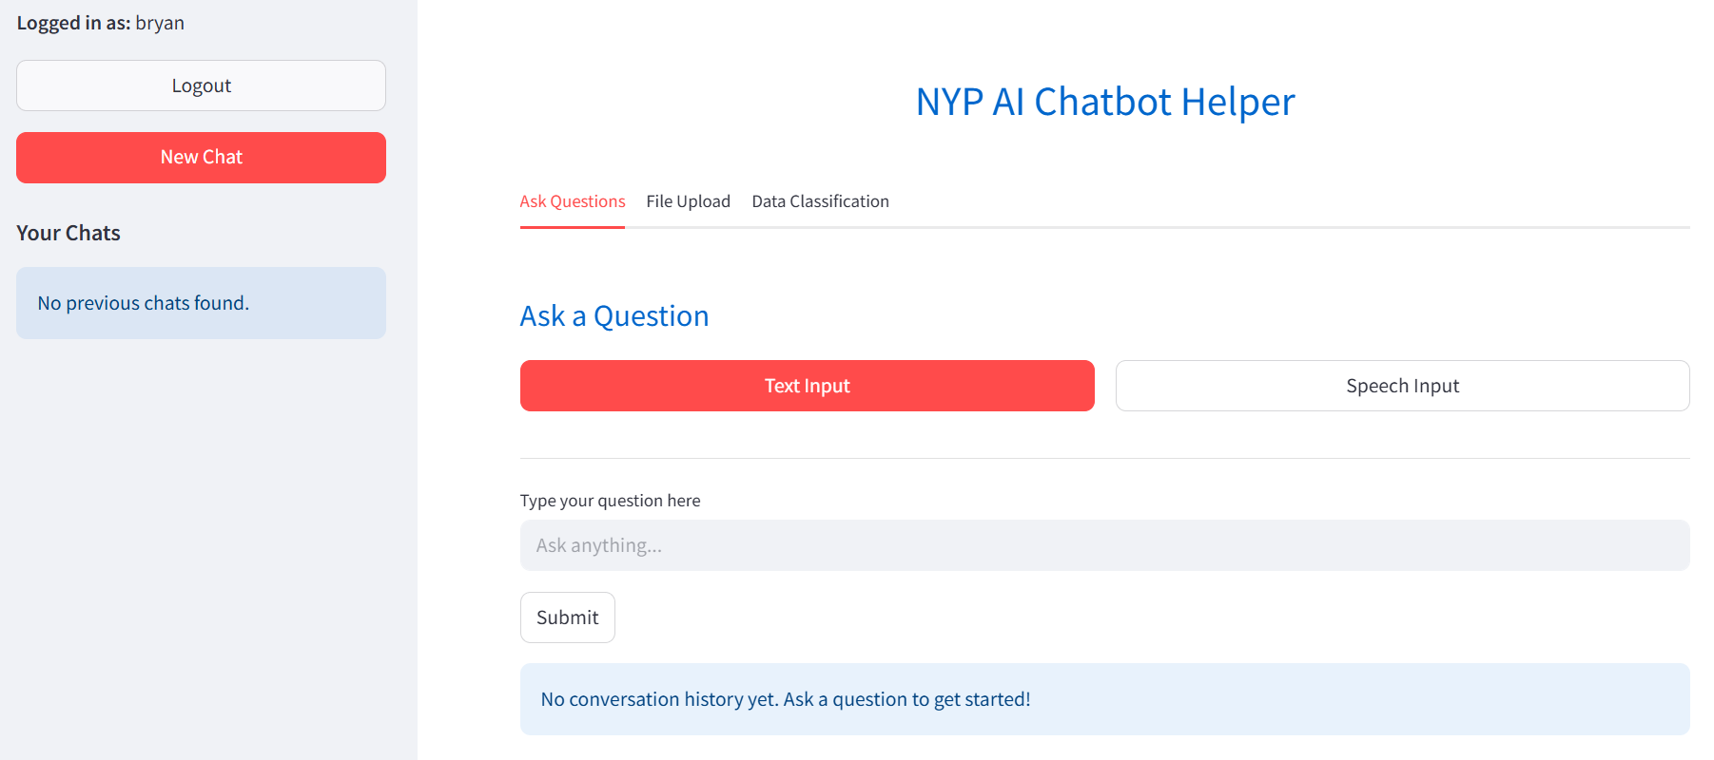
UI Design - V3.0
Version 3.0
Simple and minimalistic
Clear Call-to-Action buttons
Notes:
Our final UI is clean, minimalistic, and designed with usability in mind. We focused on clear call-to-action buttons, a personalized sidebar for managing conversations, and structured storage of chat history

Slide 25
Supporting Secure Multi-User Access
Why it matters:
In an industrial setting, multiple users must interact securely with personalized experiences.
Implementation Details:
Allowed Email List: Only specified emails can register → ensures internal control.
Unique Email Registration: Each email is linked to one user → simplifies tracking.
Backend Storage: User data is stored in a users.json file, including username and password.
Advantages:
Secure access controlled via allowed emails.
Prevents unauthorized entry.
Ensures accountability and easy monitoring

Slide 26
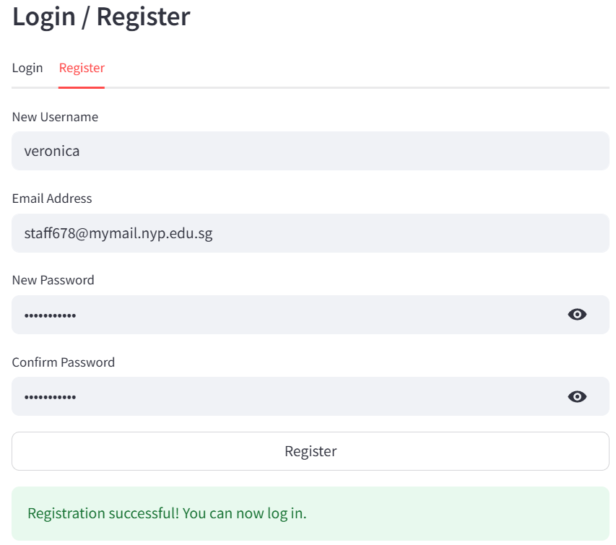
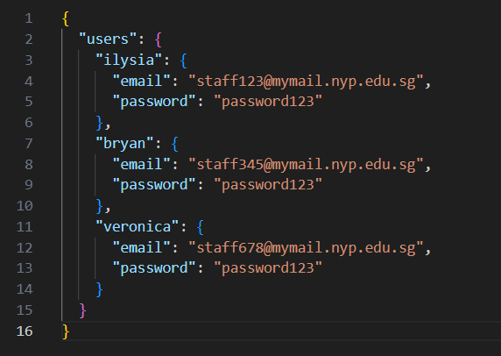
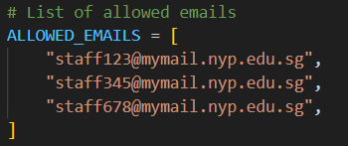
Supporting Secure Multi-User Access
Email Check
Registration
Storage in users.json

Slide 27
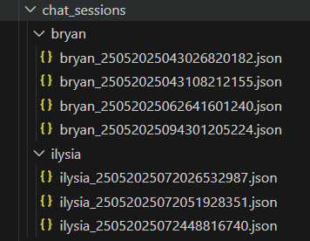
Multi-User Access - Personalized Data Storage
Why it matters:
To ensure secure and scalable multi-user support, each registered user gets their own dedicated folder containing their conversation history.
Benefits:
✔️ Data Isolation: Users only access their own files and chats
✔️ Security: Prevents cross-user data leaks
✔️ Scalability: Easy to manage and expand with more users
✔️ Organization: Keeps backend clean and efficient
Folder Structure
Notes:
To make sure our chatbot works securely for multiple users, i implemented a personalized folder system. Each time a new user registers, a dedicated folder is created for them. This folder stores all their conversation history
For example, if Bryan logs in, his data will be stored under /chat_sessions/bryan/. If Ilysia logs in, her data goes into /chat_sessions/ilyisia/. This ensures that users can’t see each other’s conversations and keeps everything organized and secure.

Slide 28
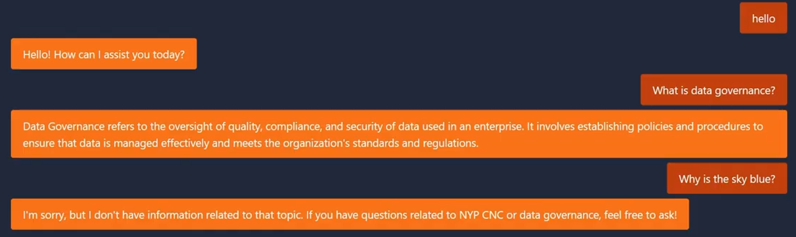
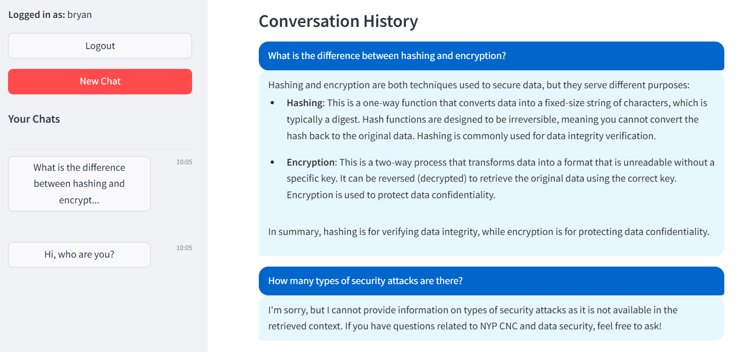
Redesigned Conversation History
Old Version
New Version
❌ Lack of chat segmentation
❌ No unique Chat IDs
❌ Limited scalability
✅ Unique Chat IDs
✅ Structured JSON Storage on frontend
✅SQLite for Persistent Memory on backend (Bryan’s part)
Notes:
Key Limitations:
Lack of chat segmentation : All conversations were lumped together, making it hard to distinguish between different topics or sessions.
No unique identifiers for chats: Difficult to track specific conversations over time.
Limited scalability : As more users joined, managing chat histories became cumbersome.
Key Improvements:
Personalized Sidebar: Displays only the user’s chats, with options to start new ones.
Unique Chat IDs: Each chat is uniquely identified, making it easy to track and retrieve specific conversations.
Structured Storage: Chats are organized by user and chat ID, improving scalability and management.

Slide 29
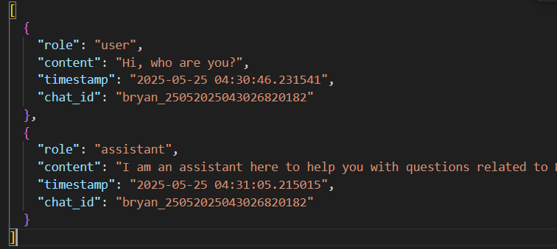
Conversation History - Implementation
How it connects to the Backend:
The chat_id links to Bryan’s SQLite persistent memory system
Ensures frontend ↔ backend synchronization
Notes:
One of the major improvements we made was redesigning how conversation history works. In older versions, chats weren't properly segmented and lacked unique identifiers."
"In Version 3.0, each chat gets a unique ID , and all messages are saved in a structured JSON file specific to that user. This allows users to revisit previous conversations easily through a personalized sidebar."
"The chat ID in this JSON file also connects to Bryan’s backend system using SQLite , so we ensure seamless history tracking across both frontend and backend.

Slide 30
Final Chatbot

Slide 31

Chatbot Demo

Slide 32
THANK YOU

